Slide 1
COMP 1537
Node & MySQL Connectivity

Slide 2
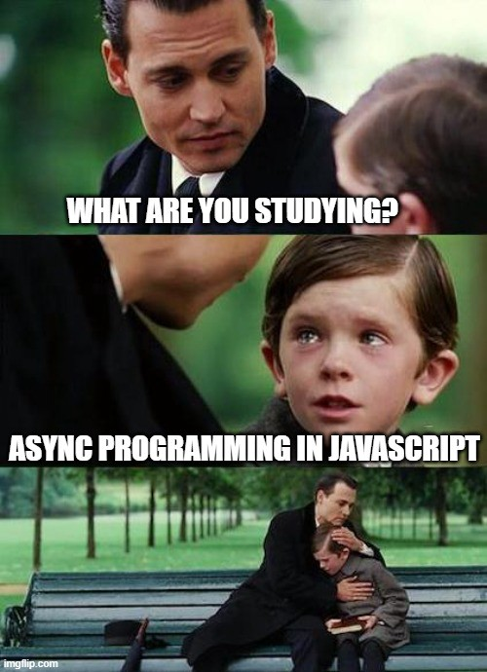
Intro to Node & MySQL
For this topic you will need:
Node.js
MySQL
If you are on OSX (Mac), download MySQL via Homebrew
If you are on Windows (PC), download XAMPP
If you are on Linux, use your package manager
This will be one last look at callbacks and asynchronous calls in JS
Although the example does use promises, we’ll skim over the details of promises for now
COMP 2537 will cover promises!
Node module required: mysql2
npm install –g mysql2

Slide 3
MysQL2 Config/Connection
“Require” mysql2, the module allows us to:
Instantiates a connection object
And pass it the:
Server name (‘localhost’, if this doesn’t work, try, “127.0.0.1”)
Admin name – usually ‘root’, unless you changed it
Password – usually empty string ‘’, or on Mac it might be ‘root’
Name of the DB – you can create a name based on the context (e.g., ‘assignment4’)

Slide 4
MysQL2 – Query with HTML (1/3)

Slide 5
MysQL2 – Query with HTML (2/3)
Line 2: connects to MySQL
Line 3 – 19: a query (first argument), a callback), second argument
Line 5: is the callback with arguments:
Error – the object that will be non-null if an error occurred
Results – an array of JS objects (in JSON format)
Fields – contains extra meta data about results (e.g., the data type of a field, etc.)
Lines 7 – 9: check for errors – either log it or send email to admin
Lines 10 – 15: construct a string via concatenation, that contains HTML
Line 16: send response to the browser
Line17: close the connection

Slide 6
MysQL2 – Query with HTML (3/3)
Line 20: tries to print the variable, myResults
Which won’t work … why?
Some observations:
We are performing string concatenation with DB results (the results array) with HTML that we embed in the string – have to be aware of the syntax within a syntax
The callback code happens at a different time than the code after line 19
Which is why line 20 prints, ‘undefined’
If we return HTML, we’ll either need an HTML file (or files), or perform string concatenation that we send to the browser – this can be slightly involved
This call is clearly meant to be AJAX – since we are only returning a snippet of HTML code – not an entire HTML document!
We should be mindful of potential errors – and log them (line 8)

Slide 7

Synchronous JS?
The previous code example was fine with the asynchronous nature of JS
As long as we did everything inside of the callback
Recall line 20 failed because it was outside of the callback
What if the results of code inside of the callback are needed outside of the callback?
We could create another callback and put it into the original callback
But this can result in callback hell (i.e., messy and hard-to-manage code)
We can instead use another technique, and it uses:
Something called Promises
With the keywords, async & await
We’ll look at promises next term, for now know that the are what allow us to do things synchronously

Slide 8
MysQL2 – Synchronous Query (1/2)

Slide 9
MysQL2 – Synchronous Query (2/2)
Line 1: the function is marked as async
For now we can look at this as a way of clearly declaring our function to be asynchronous but that the inside of the function allows some sort of synchronous behavior in it
As mentioned earlier, this allows the use of Promises, something we’ll cover in COMP 1537
Lines 2 – 8: require, instantiate, connect to the MySQL DB
Line 9: we call execute using the await operator
Execute vs query method:
Query handles DB prepared statements on the Node side, not in MySQL
Execute requires the server to handle parameter substitution … more info
The await operator forces the JS runtime to suspend execution until the code on right side of the expression returns
So line 10 will execute only when execute returns values to [rows, fields] on line 9

Slide 10

Destructuring
Wait, what the heck is this?!
JS 6 destructuring
Destructing allows us to accept an array or object as a return type from a function/method
And assign names to each of the values in the array (or names to the object properties)

Slide 11
Resources (1/1)
The example code in the slides is part of the ‘mysql-and-node’ example for COMP 1537
https://www.npmjs.com/package/mysql2
https://github.com/sidorares/node-mysql2

